Slide 1

DRO Friday Budget Briefing

Slide 2

2026 – 2027 Biennial Budget
Ohio’s Children; Ohio’s People and Workforce; Ohio’s Communities

Slide 3
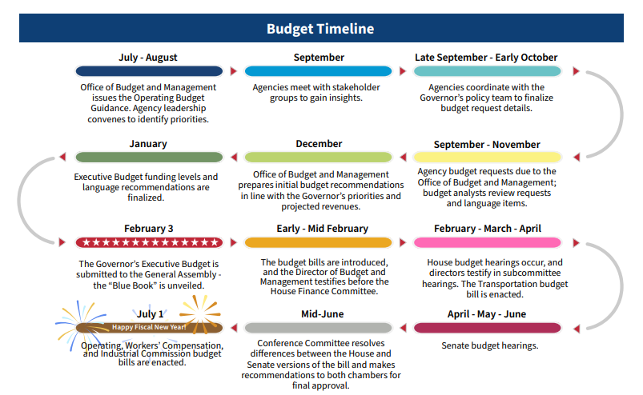
Budget Process

Slide 4
Where We Are & What Comes Next

Slide 5
Upcoming Budget Hearings
February 10th – Bill Introduced
February 12th – March 6th Committee Hearings

Slide 6
Committee Hearings
Children and Human Services (Chair – White)
Rm. 121
Department of Aging
Department of Children and Youth
Department of Jobs and Family Services
Department of Mental Health and Addiction Services
Medicaid (Chair – Gross)
Rm. 116
Department of Medicaid
Health (Chair – Schmidt)
Rm. 121
Opportunities for Ohioans with Disabilities
Department of Developmental Disabilities
Education (Chair – Fowler-Arthur)
Rm. 121
Department of Education and Workforce

Slide 7
Budget Terms
All Funds – total amount of money Ohio receives
GRF – general revenue fund, amount of money Ohio receives through sales tax, income tax, etc.
Non-GRF – amount of money Ohio received that are not produced through sales tax, income tax, etc. Most notably, this amount comes from the federal government
FY – fiscal year, this indicates the year of spending by the state, this runs from July-June each year
Line Item – a program, services, supports, or agency receiving a certain amount of funding

Slide 8
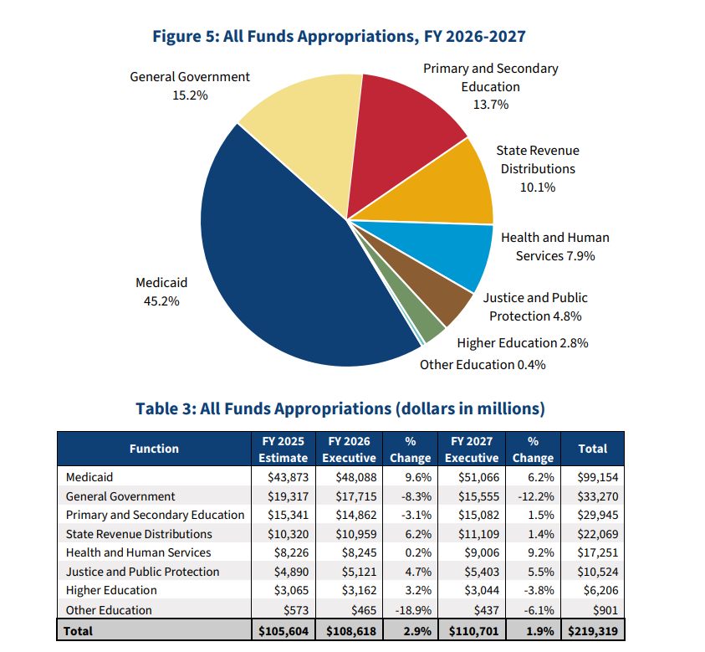
Budget Overview – All Funds

Slide 9
Budget Overview – All Funds

Slide 10
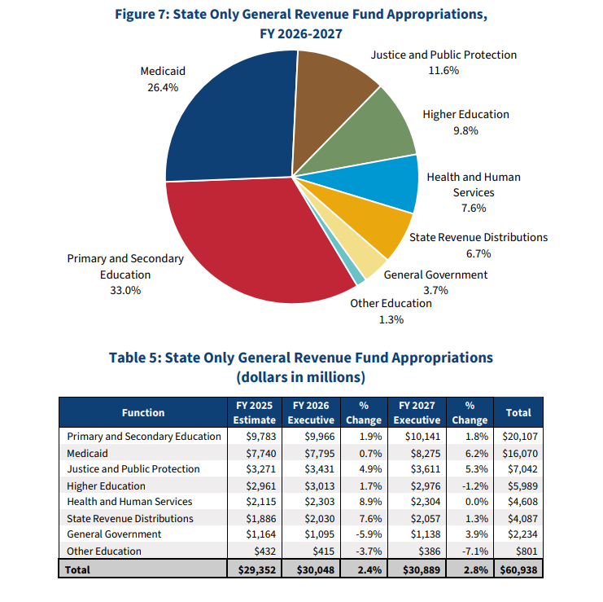
Budget Overview - GRF

Slide 11
Budget Overview - GRF

Slide 12
Budget Highlights
Ohio’s Children; Ohio’s People and Workforce; Ohio’s Communities

Slide 13
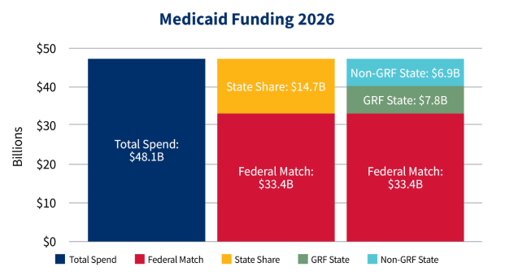
Department of Medicaid

Slide 14
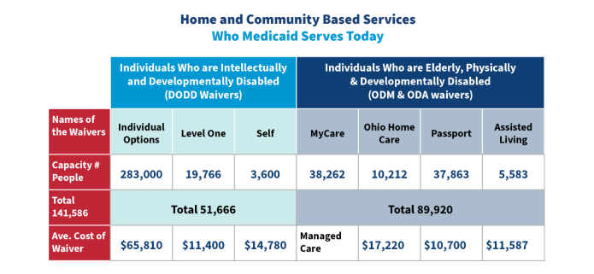
Department of Medicaid

Slide 15
Department of Medicaid Overview
3.2million Ohioans enrolled in Ohio Medicaid
Enrollment has leveled out since the pandemic but not pre-pandemic levels
Maintains rate increases for direct care worker wages
Does not include cost of living increases for wages
From $50 to $100 for personal needs allowance in nursing homes
Implementation of 1115 work requirement waiver

Slide 16
Department of Developmental Disabilities (DODD) Overview
$5.5B in 2026
$5.7B in 2027
Provides funding to more than 44,000 individuals in the home and community
425 intermediate care facilities
8 developmental centers

Slide 17
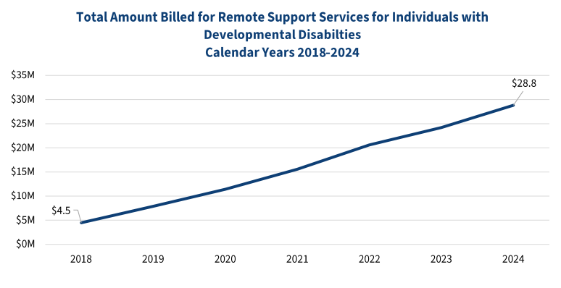
DODD

Slide 18
DODD Goals and Objectives
Provide resources and supports to enhance skills and achieve career goals through technology, peer mentorship, networking, adult day, and employment services
Improve delivery of healthcare
Empower individuals to be leaders in their communities
Improve quality of services and supports

Slide 19
DODD Key Line Items
Fund | ALI | Name | 2026 | % Change | 2027 | % Change
5Z10 | 653624 | County Board Waiver Match | $688M | 21.4% | $752M | 9.3%
3A40 | 653654 | Medicaid Services | $3.3B | 9.5% | $3.5B | 4.7%
GRF | 653407 | Medicaid Services | $1.1B | 12.2% | $1.1B | 1.2%
GRF | 322422 | Multi System Youth | $5M | 0% | $5M | 0%

Slide 20
Opportunities for Ohioans with Disabilities (OOD) Overview
Serves as Ohio’s vocational rehabilitation agency
$340M in 2026
$347M in 2027
Serves 42,000 individuals in 2024, a 14.8% increase
Average age was $16.50/hr
Continues full federal match

Slide 21
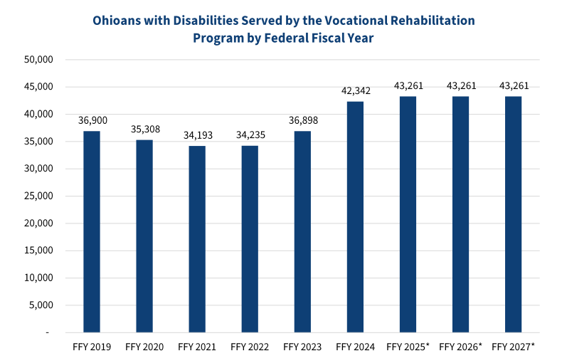
OOD

Slide 22
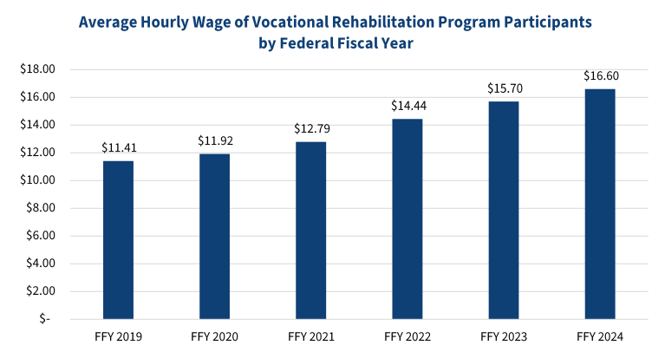
OOD

Slide 23
OOD Goals and Objectives
Serve individuals to prepare, obtain, retain, and advance employment
Establish 250 new employer partnerships to increase hiring and retention
Meet and exceed productivity goals defined by Social Security
Establish 330 partnerships with businesses, communities, venues, and attractions to accomplish accessibility and inclusion goals

Slide 24
OOD Key Line Items
Fund | ALI | Name | 2026 | % Change | 2027 | % Change
3GH0 | 415613 | Independent Living | $2.7M | 271.2% | $2.7M | 0%
3GH0 | 415627 | Independent Living Projects | $100K | -60% | $100K | 0%
GRF | 415402 | Independent Living Council | $252K | 0% | $252K | 0%
GRF | 415506 | Services for Individuals with Disabilities | $40M | 25% | $40M | 0%
GRF | 415511 | Centers for Independent Living | $1.5M | 0% | $1.5M | 0%
GRF | 415515 | DeafBlind Fund | $0 | -100% | $0 | 0%

Slide 25
Department of Behavioral Health (DBH)
$1.2B in 2026
$1.3B in 2027
Administers 6 regional psychiatric hospitals serving with over 4,000 individuals
Provides services to 11,000 incarcerated individuals
Regulates more than 2,000 mental health and addiction providers

Slide 26
DBH Goals and Objectives
Increase availability of timely, community-based crisis services
Leverage data to improve processes and patient-centered care
Identify needs to provide resources and services to build resiliency-focused solutions
Strengthen behavioral health workforce
Increase care coordination and recovery supports
These goals and objectives include expansion of the assisted outpatient treatment program to at least five new counties, expand mobile crisis, and increase number of individuals restored to competency in an outpatient setting

Slide 27
DBH Key Line Items
Fund | ALI | Name | 2026 | % Change | 2027 | % Change
GRF | 336407 | Crisis Service and Stabilization* | $17M |  | $22M | 29.4%
GRF | 336422 | Criminal Justice Services | $34.5M | 64.6% | $34.8M | 0.8%
GRF | 336510 | Residential State Supplement | $24M | 0% | $24M | 0%
QG18 | 336668 | 9-8-8 Suicide Crisis and Response | $31.6M |  | $41.2M | 30.3%

Slide 28
Upcoming Hearings
Medicaid Committee
February 11 – Joint Medicaid Oversight Committee; Office of Budget and Management
Children and Human Services Committee
February 11 – Department of Children and Youth
Education Committee
February 11 – Speech and Hearing Professionals Board; School for the Blind; School for the Deaf

Slide 29
How to Get Notified
Go to ohiohouse.gov
Select “Committees” from navigation panel
Select Committee you would like to get notified for committee hearings
Select “Mailing List” from the top navigation panel
Enter email and select “Submit”
Notes:
You may also select “Manage Subscriptions” and sign up or unsubscribe for multiple committees

Slide 30
Stay Updated with DRO
Subscribe to Brittanie’s Blog
Attend Weekly Briefings
Check Email from DRO with updates on committees and how to testify

Slide 31
Contacts
Brittanie Maddox, Community Engagement and Advocacy Specialist
bmaddox@disabilityrightsohio.org
Jordan Ballinger, Policy Director
jballinger@disabilityrightsohio.org

Slide 32
Questions?

