Slide 1
DRO Friday Budget Briefing
Jordan Ballinger
Policy Director

Slide 2
Omnibus Updates
DeafBlind Funding has been restored
Medicaid Median Rate Requirement removed
Group VIII trigger language and transition still in
No DSP Task Force
No additional funding for DSPs or long-term stability for wage growth

Slide 3
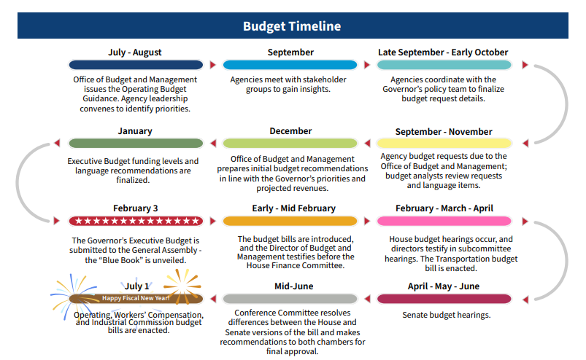
Budget Process

Slide 4
Where We Are & What Comes Next

Slide 5

Spring Break
Weeks of April 14th and 26th

Slide 6
Upcoming Budget Hearings
Committee Hearings Weeks of:
April 28th
May 5th
May 12th
Senate Finance Hearings:
Week of May 26th

Slide 7
Committee Hearings
Education Committee (Chair – Brenner)
South Hearing Room
Department of Education and Workforce
Health (Chair – Huffman)
South Hearing Room
Departments of Aging, Children and Youth, Job and Family Services, and Behavioral Health
Medicaid (Chair – Romanchuk)
Grant Hearing Room
Department of Medicaid
Department of Developmental Disabilities
Opportunities for Ohioans with Disabilities

Slide 8
Submitting Testimony in Senate
Do not email testimony to Chair’s office
Submit testimony directly through committee website

Slide 9
Submitting Testimony in Senate
Go to ohiosenate.gov
Select “Committees” drop down menu
Select “Standing Committees”
Select committee you wish to submit testimony in
Select “Meetings” within committee menu
Select the date you wish to submit testimony
Select “Upload Testimony” and upload testimony form your computer
Testimony must be submitted 24hours prior to committee hearing

Slide 10
Upcoming Briefings
No briefings on:
April 18th
April 25th
Next briefing
May 2nd

Slide 11
Questions?

